Slide 1


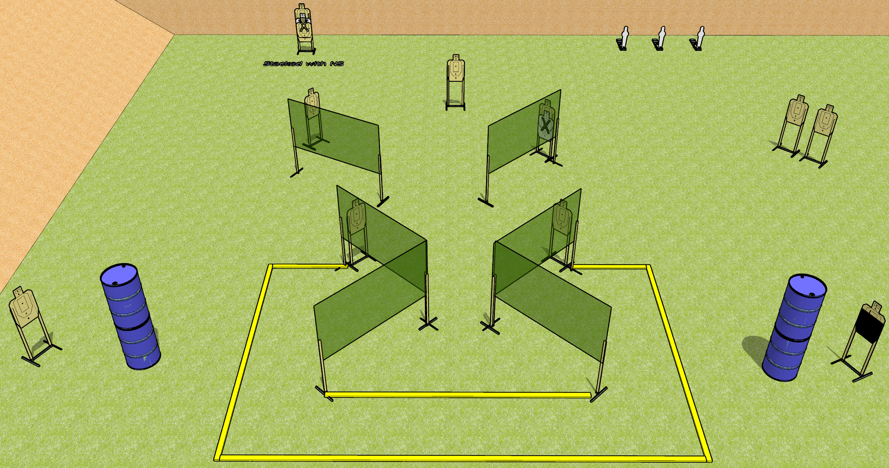
 | Dothan Gun Club – USPSA Match Bringing Pain Again Course Designer : Drew Coleman
Round Count 25 rounds 12 USPSA 3 mini poppers
Equipment List 2 medium fault lines 10 wall feet 1 action target

Slide 2
Bringing Pain Again
Written Stage Briefing
Bringing Pain Again is a 25 round, 125 point, Comstock course of fire. There are 12 USPSA targets and 3 mini poppers. The best 2 hits on paper will score, and steel must fall to score. The start signal is audible.
Handgun start position is in the shooting area, wrists below belt. Handgun is loaded and holstered.
PCC start position is in the shooting area, stock on belt. Carbine is loaded with safety on.
On start signal, engage targets as they become available from within the shooting area.

